Slide 1

Instructions
Welcome to our second online training session!
Please read through this deck in advance of next week’s session.
On some slides you will see an icon - please click to hear more.
Next week’s session will be an interactive video call which will test your understanding of the material!

Slide 2
Recap: Intro to Agile

Slide 3


AGILE
Scrum
Lean Software Development
Kanban
XP (Extreme Programming)
Crystal Clear
….
CI (Continuous Integration)
CD (Continuous Deployment)
FDD (Feature Driven Development)
TDD (Test Driven Development)
...

Slide 4
Agile Software Development
Based on the concept of iterative development
Collaboration - Key ingredient which refines requirements and solutions between self-organizing cross-functional teams
A disciplined project management process that encourages frequent inspection and adaptation
A leadership philosophy that encourages teamwork, self-organization and accountability
A set of engineering best practices intended to allow for rapid delivery of high-quality software
A business approach that aligns development with customer needs and company goals

Slide 5
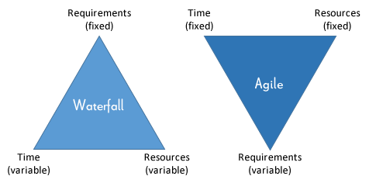
Waterfall vs Agile

Slide 6
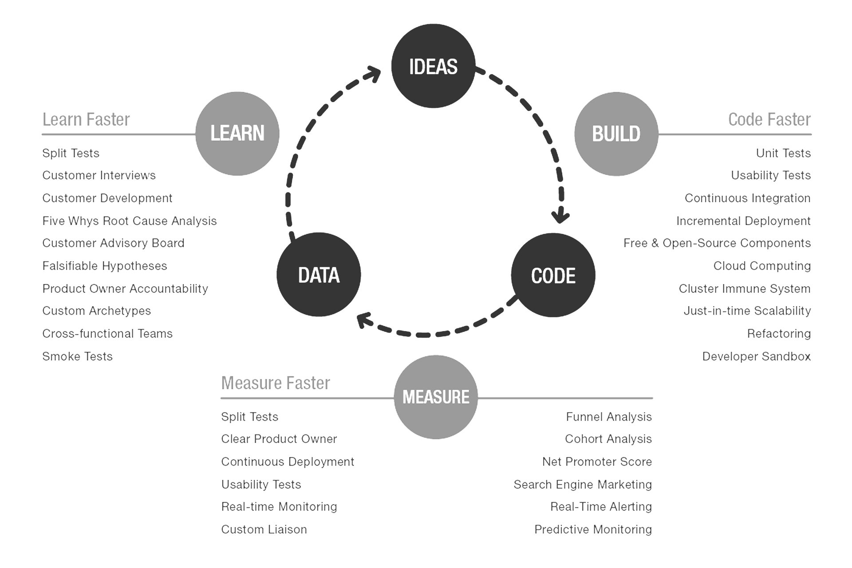
MVP
“MVP is the fastest way to get through the Build –Measure – Learn feedback loop with the minimum amount of effort.”
Eric Ries, The Lean Start-up

Slide 7
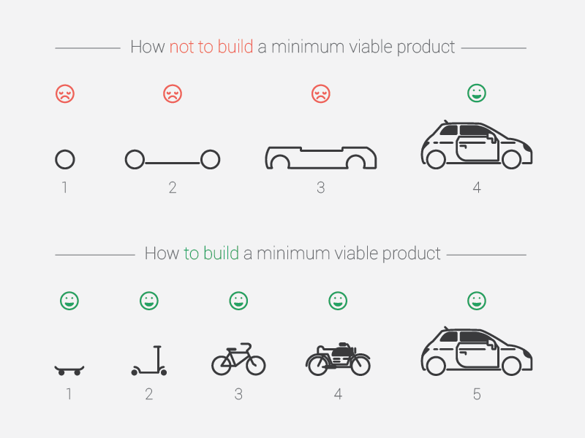
MVP

Slide 8




Agile Manifesto
There are 4 key values which are the foundation for agile ways of working.
INDIVIDUALS & INTERACTIONS
Over Processes and Tools
WORKING SOFTWARE
Over comprehensive documentation.
CUSTOMER COLLABORATION
Over contract negotiation
RESPONDING TO CHANGE
Over following a plan

Slide 9
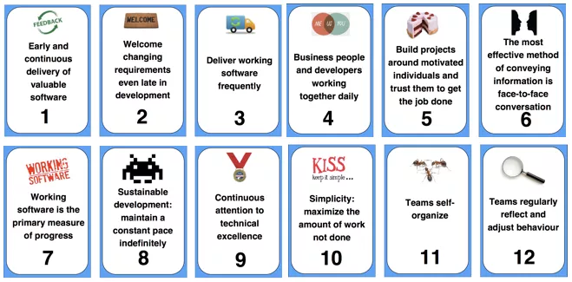
Agile Principles Summary
Notes:
Alice
The core Agile Manifesto values are captured in twelve principles:
Customer satisfaction through early and continuous software delivery - Customers are happier when they receive working software at regular intervals, rather than waiting extended periods of time between releases.
Accommodate changing requirements throughout the development process - The ability to avoid delays when a requirement or feature request changes.
Frequent delivery of working software - Scrum accommodates this principle since the team operates in software sprints or iterations that ensure regular delivery of working software.
Collaboration between the business stakeholders and developers throughout the project - Better decisions are made when the business and technical team are aligned.
Support, trust, and motivate the people involved - Motivated teams are more likely to deliver their best work than unhappy teams.
Enable face-to-face interactions - Communication is more successful when development teams are co-located.
Working software is the primary measure of progress - Delivering functional software to the customer is the ultimate factor that measures progress.
Agile processes to support a consistent development pace - Teams establish a repeatable and maintainable speed at which they can deliver working software, and they repeat it with each release.
Attention to technical detail and design enhances agility - The right skills and good design ensures the team can maintain the pace, constantly improve the product, and sustain change.
Simplicity - Develop just enough to get the job done for right now.
Self-organizing teams encourage great architectures, requirements, and designs - Skilled and motivated team members who have decision-making power, take ownership, communicate regularly with other team members, and share ideas that deliver quality products.
Regular reflections on how to become more effective - Self-improvement, process improvement, advancing skills, and techniques help team members work more efficiently.

Slide 10
Scrum

Slide 11
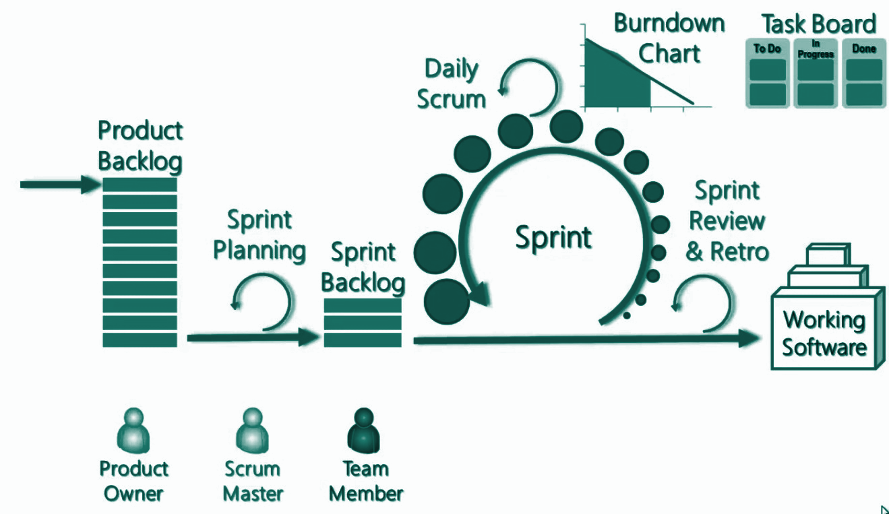
What is Scrum?
SCRUM is one of many agile methodologies used by software companies since 1993.
It is particularly characterised by its sprints, ceremonies and roles (read on!).
A Sprint is a a time-box of one month or less during which a “Done”, useable, and potentially releasable product increment is created.
Sprints have consistent durations.
Work is taken into a sprint from the product backlog, defined by a Product Owner. Once the sprint starts scope cannot be added to the sprint..
A new Sprint starts immediately after the conclusion of the previous Sprint.
At the end of of each sprint the team should be able to ship working software.

Slide 12





Scrum Roles
Scrum is characterised by specific roles which have distinct responsibilities:
Product Owner
Scrum Master
Team Member
Takes the inputs of what the product should be and translates them into a product vision and backlog.
Does whatever it takes to make the Scrum Team successful, such as removing organizational impediments, facilitating meetings, acting as a gatekeeper so no one unnecessary interrupts the team's work.
Develops the product envisioned by the Product Owner. The team should be cross functional i.e. include all the skills required to build a potentially shippable product.

Slide 13








Scrum Process
Move fast (<1 week). Focus on getting just enough scope and structure to understand the desired outcomes and the highest priorities within those.
The whole Scrum team: How did we do and how can we work better?
Estimate (story points) the detailed items. Pick just enough that seem to be deliverable in one sprint.
Agent product offering
...
Agent task mgmt
UVA1,2,3
Design, develop, unit test, integration test, and package code.
Sprint goal
Sprint retrospective
High-level scoping
Projects
2 week sprint
Deliver & release code
Deploy and release the increment (i.e. code) into Prod
Backlog
Sprint planning
Backlog refinement
(for next 1-3 sprints)
Sprint review (incl. demo)
Many large, high-level items (epics). A few smaller, detailed ones (stories) - focused on the initial high priorities.
While the spring runs, review and revise the priorities in the backlog. Refine/detail the next set of epics into stories.
Demo the increment, discuss robustly, capture feedback for next sprints.
= Product & Engineering
= Functional stakeholders

Slide 14
Pros & Cons of Scrum Framework
Pros | Cons
Clear roles and ceremonies makes roles and responsibilities clear and provide governance | Requires high levels of testing maturity as things need to be fully tested within sprint
Makes it easier to track and communicate performance | Daily team meetings and ceremonies can be frustrating unless run well.
Large projects are divided into easily manageable sprints | Requires someone to act as scrum master - ideally not as a part time role
Team face limited change within the sprint but the approach allows for lots of change in future sprints | Harder to scale to large teams / multiple teams
Focus on inspect and adapt supports continuous improvement | Understanding and commitment is key to making the approach work

Slide 15

Scrum Master

Slide 16

Scrum Master
FACILITATOR / REMOVE BARRIERS
PROTECT TEAM FROM EXTERNAL INTERFERENCE
ENFORCE SCRUM PRINCIPLES
IMPROVE PRODUCTIVITY
ENABLES COLLABORATION

Slide 17
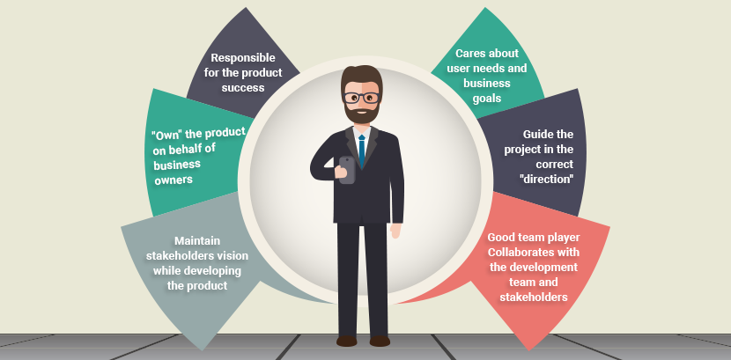
Product Owner

Slide 18
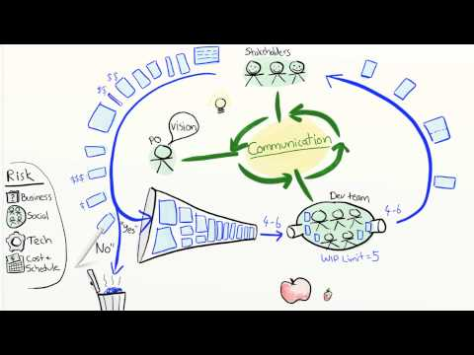
Product Owner
Notes:
Run to 5 mins 40 seconds.
RuVideo - https://www.youtube.com/watch?v=502ILHjX9EE

Slide 19

Scrum Team
A scrum team is non hierarchical and cross functional team.
Typically you might find a front end dev, a server side dev, QA and whoever else you need to build shippable software.
But you might also find non technical roles in a team.
Team members should not switch or share time with other teams.
Remember the multi-tasking game from last time? Context switching is inefficient!

Slide 20
Ceremonies
Week 1 | Monday | Tuesday | Wednesday | Thursday | Friday
 | Daily standup | Daily standup | Daily standup | Daily standup | Daily standup
 |  |  | Backlog Refinement | Demo | Sprint Retrospective
Week 2 | Monday | Tuesday | Wednesday | Thursday | Friday
 | Sprint Planning | Daily standup | Daily standup | Daily standup | Daily standup
Week 3 | Monday | Tuesday | Wednesday | Thursday | Friday
 | Daily standup | Daily standup | Daily standup | Daily standup | Daily standup
 |  | Prioritization | Backlog Refinement | Demo | Sprint Retrospective
Week 4 | Monday | Tuesday | Wednesday | Thursday | Friday
 | Sprint Planning | Daily standup | Daily standup | Daily standup | Daily standup
Week 5 | Monday | Tuesday | Wednesday | Thursday | Friday
 | Daily standup | Daily standup | Daily standup | Daily standup | Daily standup
 |  | Prioritization | Backlog Refinement | Demo | Sprint Retrospective
Daily Standup (15 minutes each day)
Attendees: Scrum team
Backlog Refinement (1 hour, 1 week before new sprint begins)
Attendees: Scrum team
Demo(½ - 1 hour, the day before the end of the sprint) Attendees: Scrum team, Business Stakeholders
Sprint Planning(½ - 1 hour, day 1 of new sprint) Attendees: Scrum team
Sprint Retrospective(½ hour, last day of the sprint)
Attendees: Scrum team

Slide 21
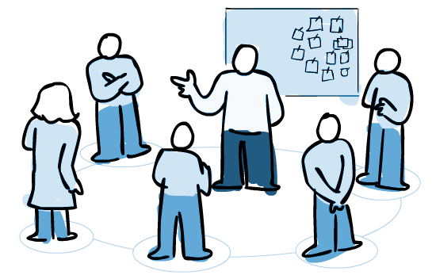
Daily Scrum
Keep in mind:
Same Place, Same Time
Stand-up to keep it focused
Focus on the backlog – but don’t be too task oriented
Keep a Blockage list and use it to Start the Day
Huddle so that everyone can hear
Signal the end with a comment to keep energy up
Late arrivals speak first
Rotate facilitator
Many faces of Jack Sparrow
Speak about:
What did I do yesterday?
What am I doing today?
What are my blockers?
Do I need help?
Notes:
Objective
To set the context for the coming days work
Participants
Scrum master, product owner, Software and QA engineers
When
In the morning
Duration
Time-boxed to 15 minutes
Inputs
What you did yesterday
What you will do today
ANy impediments in your way
Tips

Slide 22
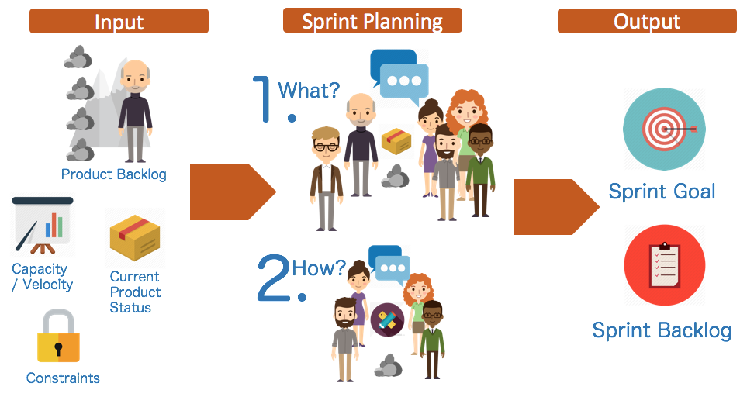
Sprint Planning
Notes:
Participants
Scrum master, product owner, entire scrum team
When
At the beginning of a sprint
Duration
Roughly 1hr
Inputs
Product owner describes highest priority features to the team
The product owner sets the goal and the team commits to what they think they can achieve in the upcoming sprint.
Start of sprint
Whole team should be available
Goals set from a prioritised, refined backlog
Stories are estimated
Team capacity is understood
Team commits stories

Slide 23

Backlog Refinement
To ensure that the backlog is refined and the team can pick up stories ready for future sprints the team should spend around 10% of each current sprint refining for future sprints.
This activity occurs on a regular basis and may be an officially scheduled meeting or an ongoing activity. Some of the activities that occur during this refinement of the backlog include:
removing user stories that no longer appear relevant
creating new user stories in response to newly discovered needs
re-assessing the relative priority of stories
assigning estimates to stories which have yet to receive one
correcting estimates in light of newly discovered information
splitting user stories which are high priority but too coarse grained to fit in an upcoming iteration
“I’m glad we all agree”
?

Slide 24
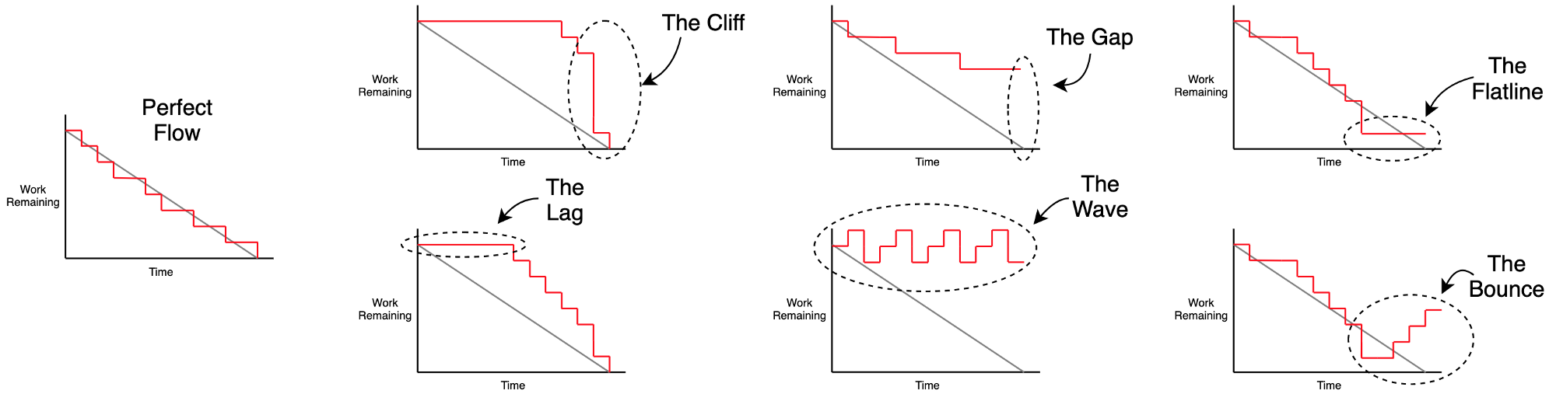
Sprint Review
The scrum team demo their work to the product owner and stakeholders who review and feedback on the work that has been done in the sprint. Sprint results to be demo’d may include non-software outputs
The review should be a chance for the team to celebrate their accomplishments as well as review their results. During the review the team should look at burndown charts and sprint velocity.
The review provides another opportunity for feedback, allowing the team to fold in changes in priority or requirements into the next Sprint. However, feedback shouldn't overturn accepted / rejected story status.

Slide 25
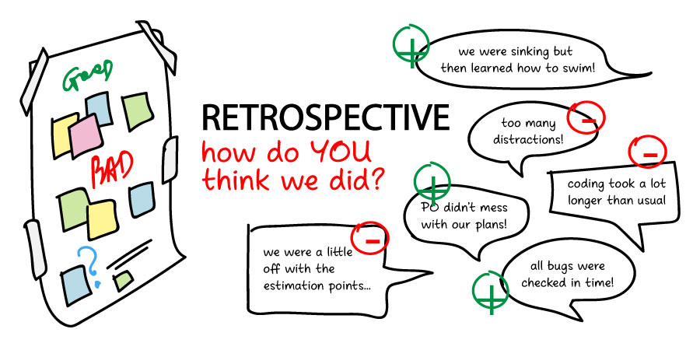
Sprint Retrospective
During the retro the whole team reflect on what has gone well and what can be improved for next sprint
Facilitation tips:
Review the previous retro actions at the beginning
Use an online board to capture feedback (saves writing up notes)
Objective, reflective, interpretive, decisional
BLAME FREE - avoid reflecting on individual performance by focus on the impediments that slowed them down.
Mix it up each sprint!
Create an action plan

Slide 26
Sprint and Velocity
A sprint is a bucket of fixed size. Stories are given points and then during sprint planning stories are added to the bucket. .
Sprint
1
2
1
1
2
1
2
The Stories
with Story Points
2
2
1
1
2
4
1
1
2
1
1
2
4
4

Slide 27
Planned Velocity
The initial capacity of ‘Agile Bucket’ = planned velocity - how much the team think they can deliver. However actual velocity is used for future sprints - this ensures the sprint plan is accurate as it is based on previous velocity not optimistic estimation
Planned
Velocity
Actual
Velocity
Next Planned
Velocity
1
1
2
1
1
2
2
2
2
2
= 16
= 12
= 12
1
1
2
1
1
2
4
4
4
4

Slide 28
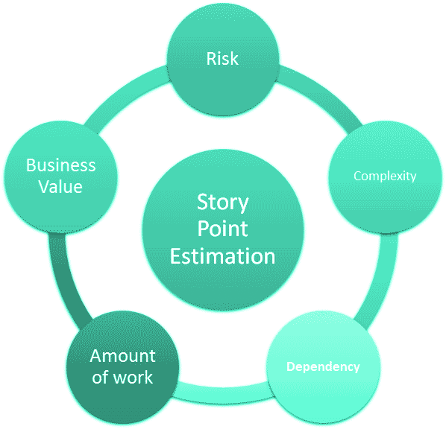
Estimation
An estimate is our best guess for what can be achieved and by when, and gives a Product Owner insight to prioritise.
Estimation is hard. For software developers, it's among the most difficult aspects of the job, taking in multiple factors.
Estimation is done in story points not man days. This is because story points better capture unknowns and complexities.
Estimation is a team sport - everyone has a voice and the team should go with the higher estimates of junior team members if they don’t match.
Use triangulation / reference stories to get a relative sense of size of the story.

Slide 29

Planning Poker Technique
Planning Poker is a technique used to calculate story points using the Fibonacci sequence. The Fibonacci sequence consists of a series of numbers that are the summation of the two previous numbers starting with 0 and 1 (1,2,3,5,8,13, 21….). Nowadays you can find free online tools to help facilitate planning poker over a call.
Steps
Each estimator is given a set of cards containing only the numbers that are going to be used (we use the sequential sequence)
Product owner reads a user story and its discussed briefly
Each estimator selects a card that is his or her estimate
Discuss differences (Especially Outliers)
Re-estimate until estimates converge
Notes:
How are we doing estimation? Are we doing it well? Could we be doing it differently?

Slide 30
The end!
Look forward to seeing you next week for the training session.

